Slide 1
On the 2012 Drought and other items of interest
Daryl Herzmann
Assistant Scientist, ISU Agronomy
akrherz@iastate.edu

Slide 2
Don’t like what you see? Do what this guy did!
Getty/AP

Slide 3
What is a Drought?
American Meteorological Society
Drought is a relative term, therefore any discussion in terms of precipitation deficit must refer to the particular precipitation-related activity that is under discussion.
Wikipedia
Drought is an extended period of months or years when a region notes a deficiency in its water supply whether surface or underground water.
National Drought Mitigation Center
No single operational definition of drought works in all circumstances
Federal Government Drought Declaration
… as reported in the U.S. Drought Monitor when any portion of a county meets the D2 (Severe Drought) drought intensity value for eight consecutive weeks. A county that has a portion of its area in a drought intensity value of D3 (Extreme Drought) or higher at any time during the growing season also would be designated as a disaster area.

Slide 4
Which has greater impacts?
For Iowa?
Getting no precipitation between 1-14 July
Getting no precipitation between 1-14 February
For Lake Tahoe, CA?
Getting no precipitation between 1-14 July
Getting no precipitation between 1-14 February
For Chicago Cubs?
No World Series win since 1906
For New York Yankees?
No World Series win since 2009

Slide 5
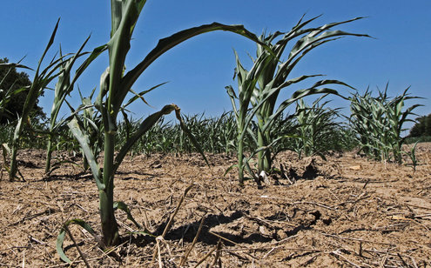
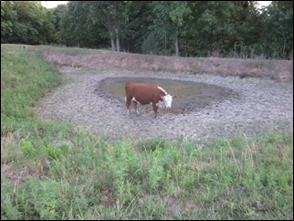
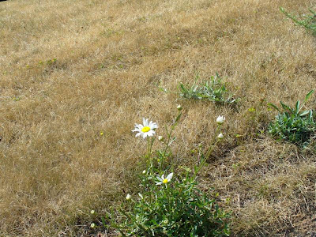
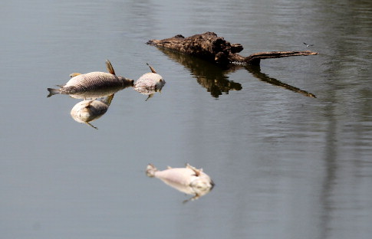
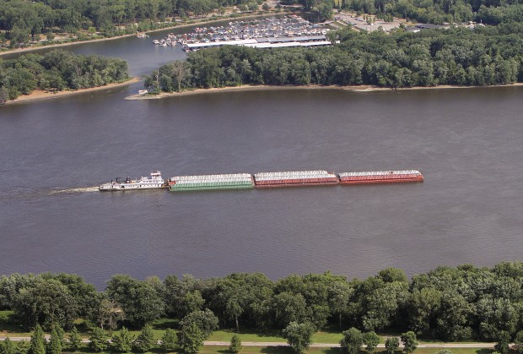
Drought Definition: Focus on Impacts.
Images from National Drought Email List

Slide 6
About 2012 Drought

Slide 7
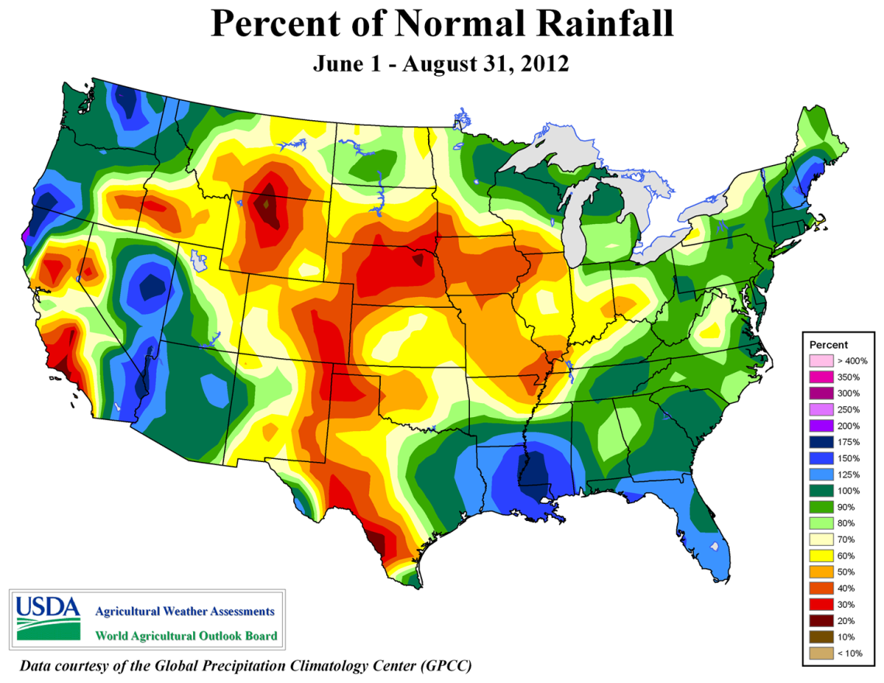

Slide 8
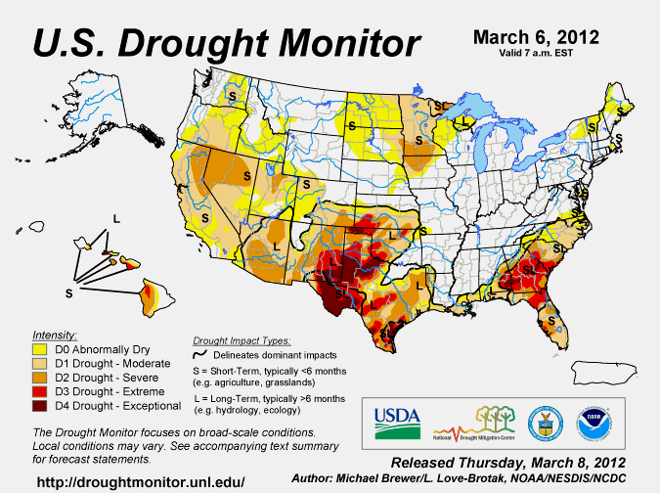

Slide 9
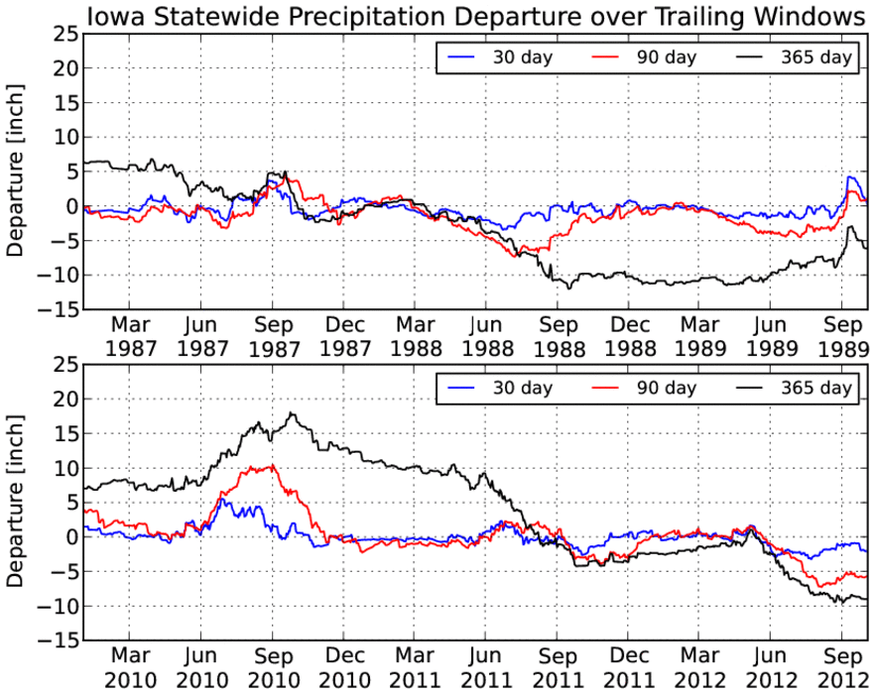
1988
2012

Slide 10
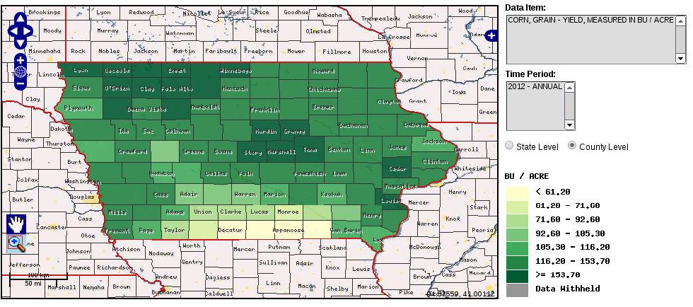
2012 Corn Yield By County
USDA NASS Quickstats

Slide 11
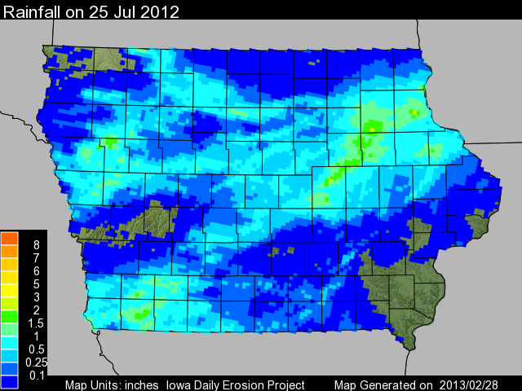
Billion Dollar Rainfall?

Slide 12
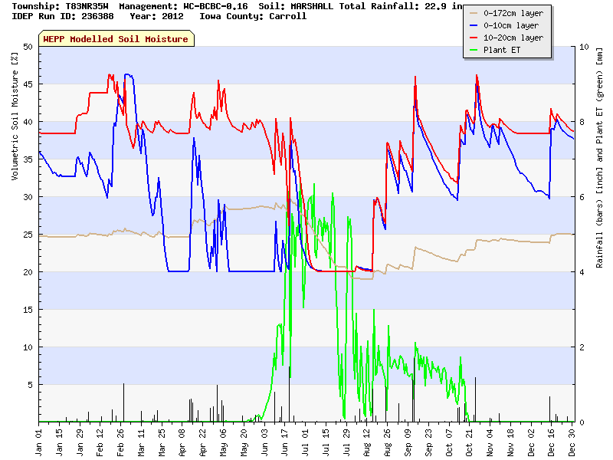
Carroll County

Slide 13
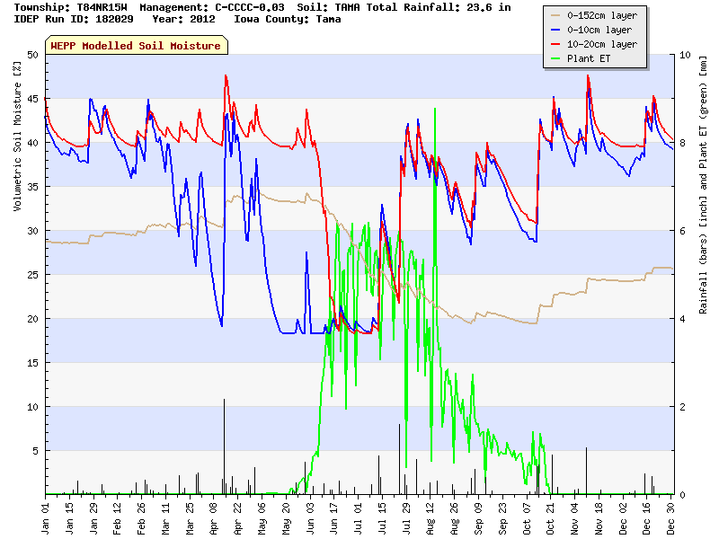
Tama County

Slide 14
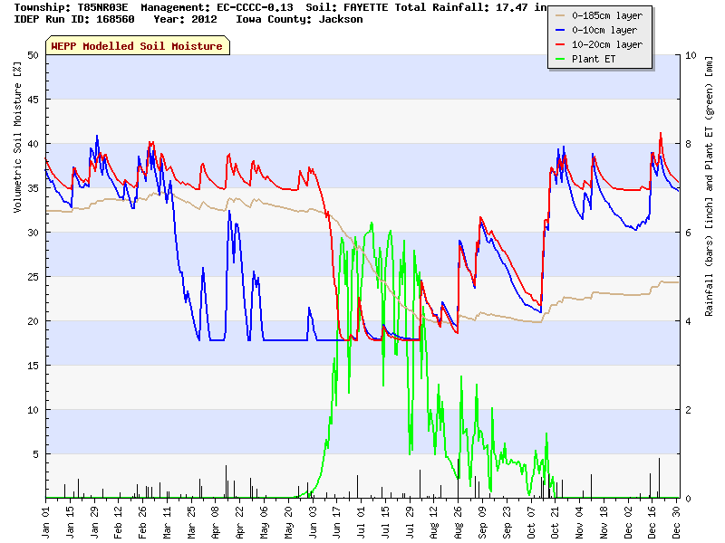
Jackson County

Slide 15
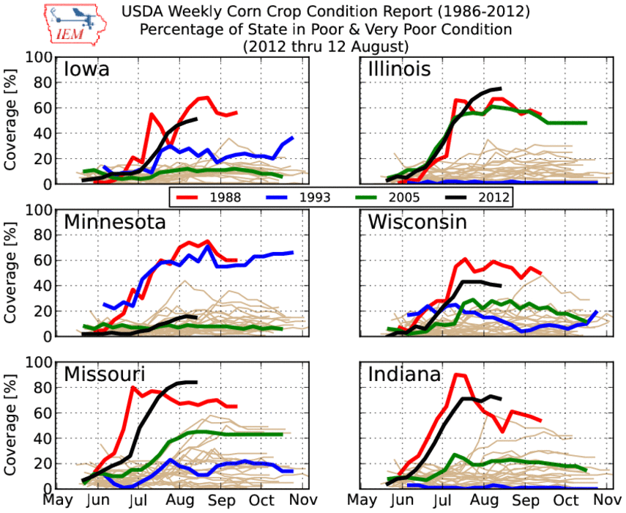

Slide 16
The lack of rain was not the only problem

Slide 17
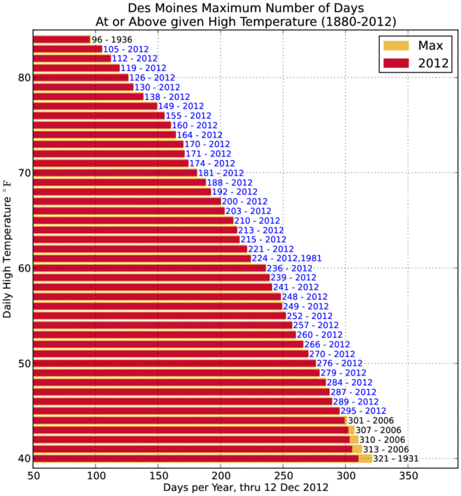

Slide 18
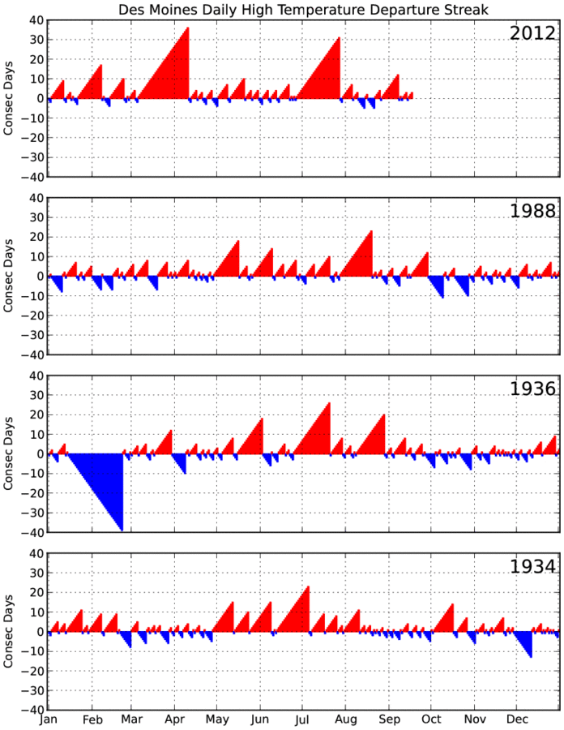

Slide 19
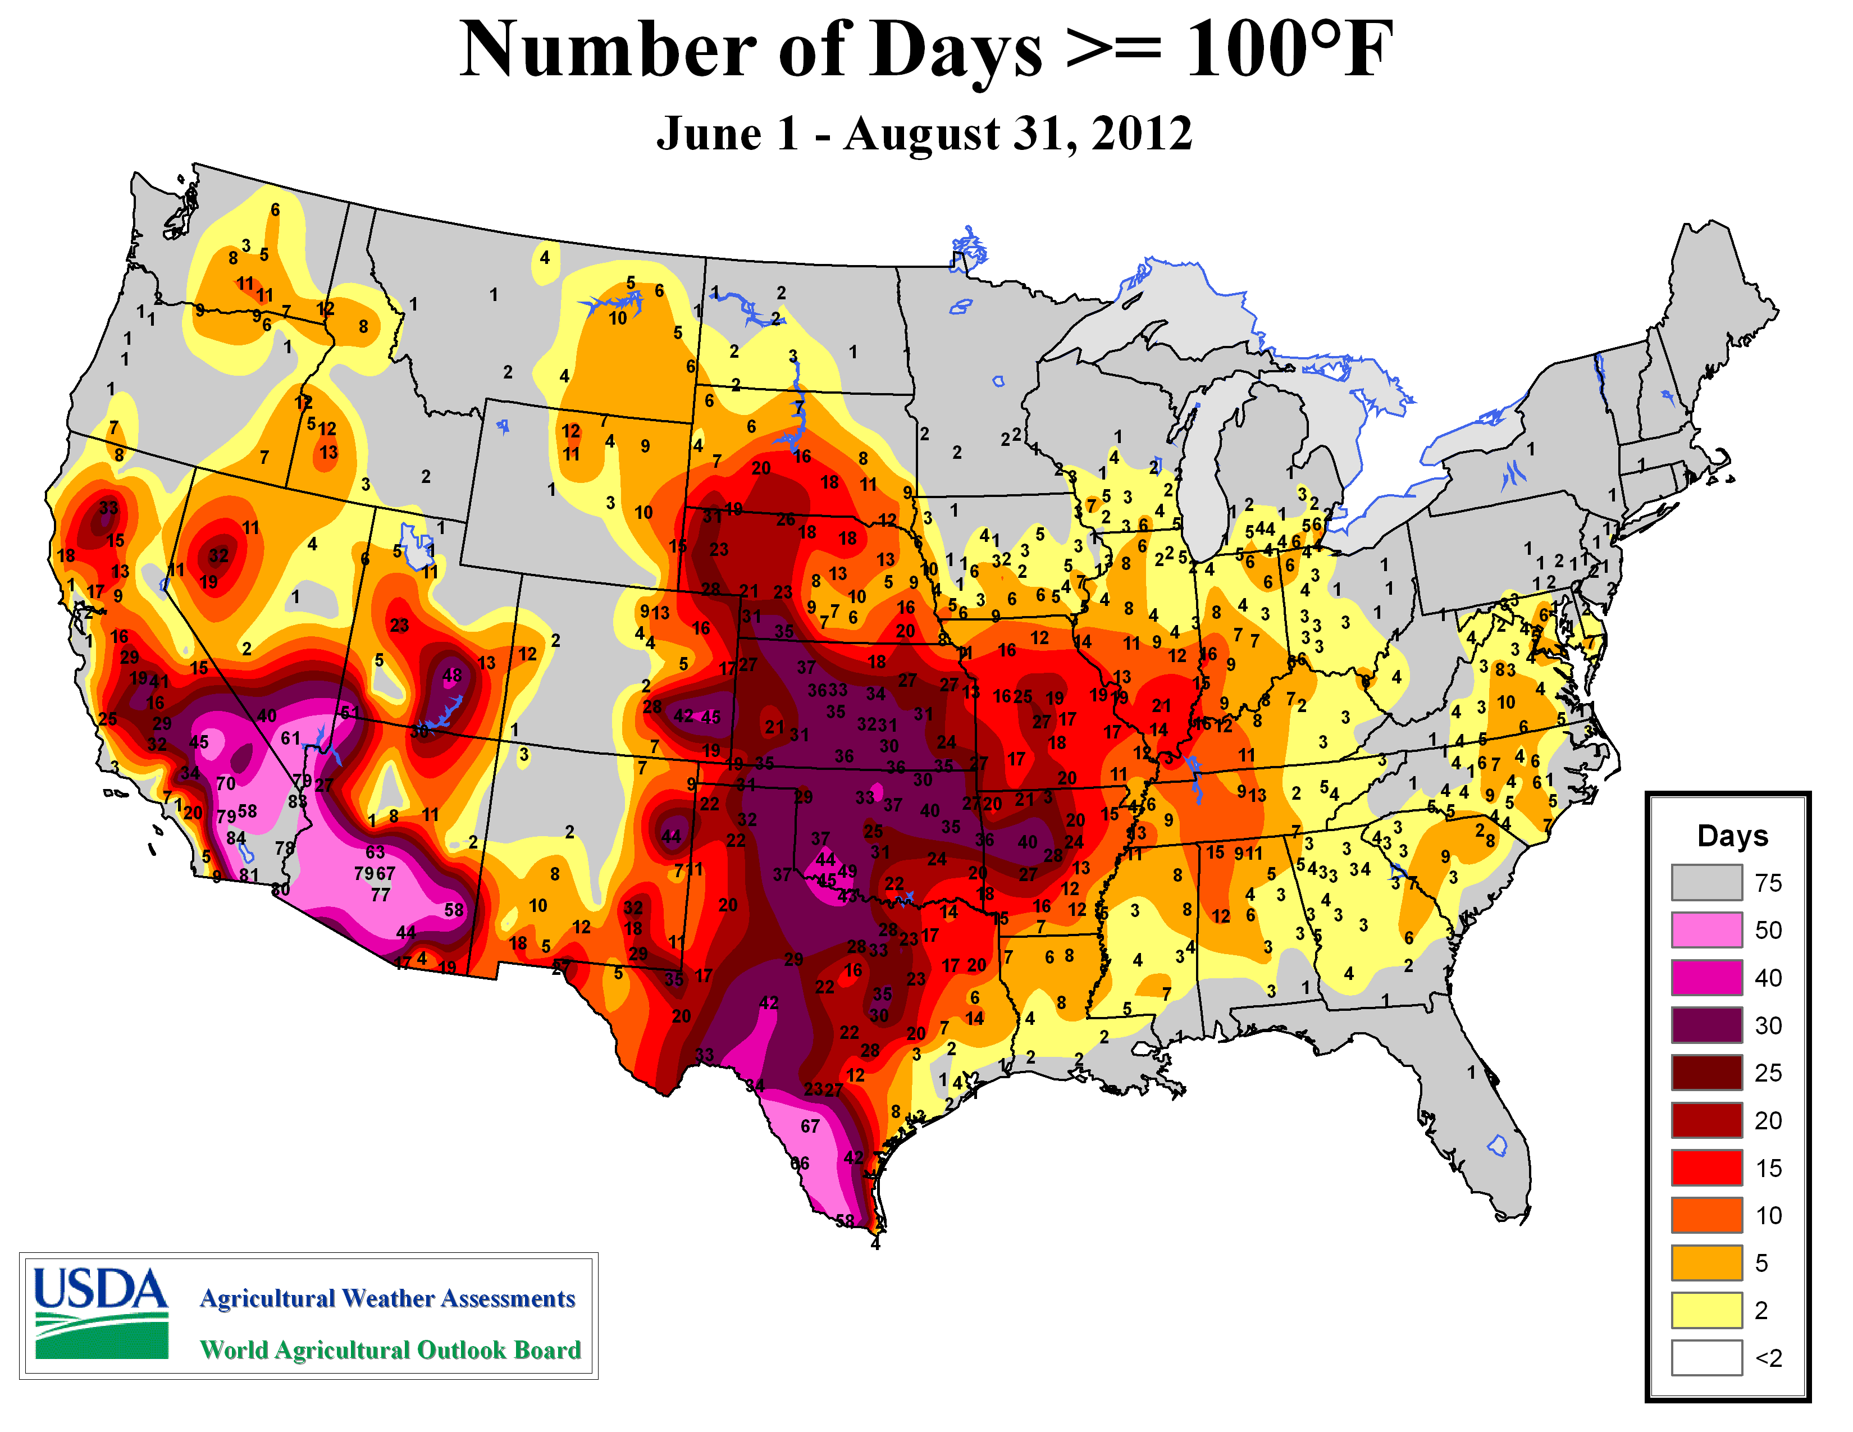

Slide 20
2012 Summary
Spring soil moisture reserves were a huge help for those locations that got late July / early August rainfall
2012 was not a failure in Iowa due to some limited and very timely rainfalls (Jul 25th)
Ridiculously hot March and mid April hard freeze were somewhat forgotten

Slide 22
My Thoughts on 2013
Winter precipitation / snowfall is not as important as media makes it to be.
Runoff
Sublimation, evaporation
Just not enough of it
March, April, May are way more important
Current soil moisture is a critical concern, we need to replenish before growing season (10+ inches of rain). Much different today than 2012.

Slide 23
ISMMS001

Slide 24
Time for Questions?
Daryl Herzmann
http://mesonet.agron.iastate.edu
515.294.5978
akrherz@iastate.edu

